Slide 1
Microsoft SQL Server Analysis Services

Slide 2
Day 1/4
Business Intelligence
OLTP and OLAP
Data ware house concepts
Dimension Modeling
What is Fact and Dimension
What are the types of Fact and Dimension.
Dimension Hierarchy
What is cube
Adding dimension attributes.
BI Semantic Model

Slide 3
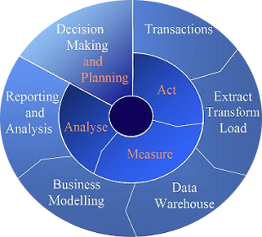
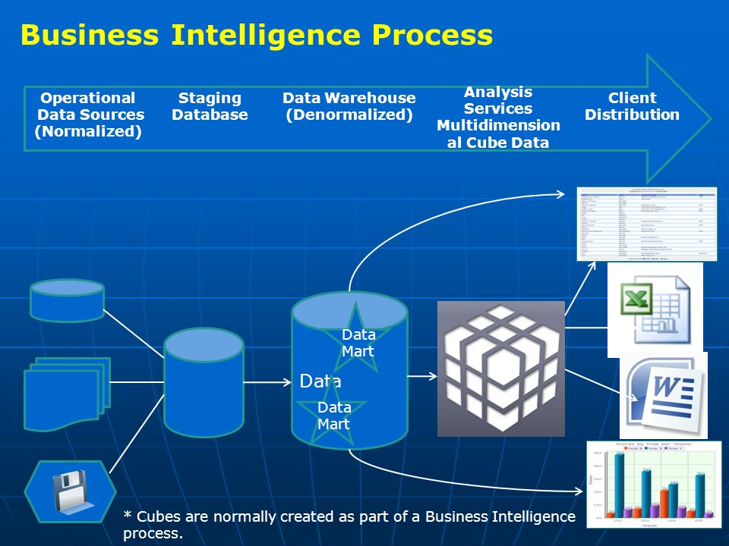
Business Intelligence
Business Intelligence is process of delivering accurate and useful information to the appropriate decision makers within necessary timeframe to support effective decision making,Perfomance evaluation, future prediction.

Slide 4
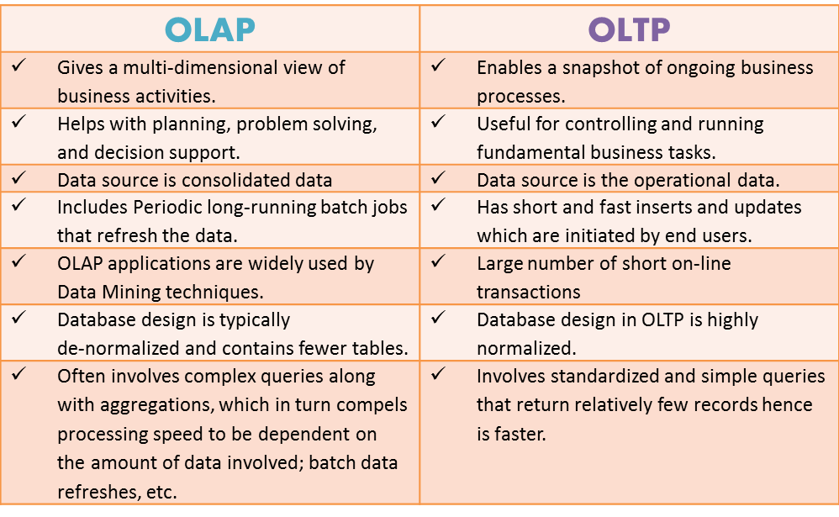
OLAP Vs OLTP

Slide 5
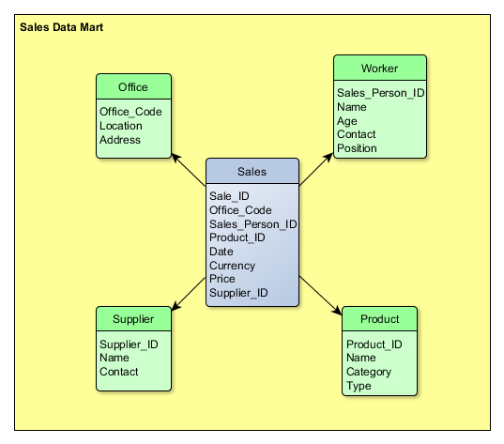
Data Mart
Data mart is subject oriented subset of data warehouse which facilitate analysis and reporting of data.
Subject oriented means it is specific to any organizational department such as Sales,inventory,HR.
Concentrates on integrating information from a given subject area or set of source systems.
Usually data mart is oriented
to specific business line or team.

Slide 6
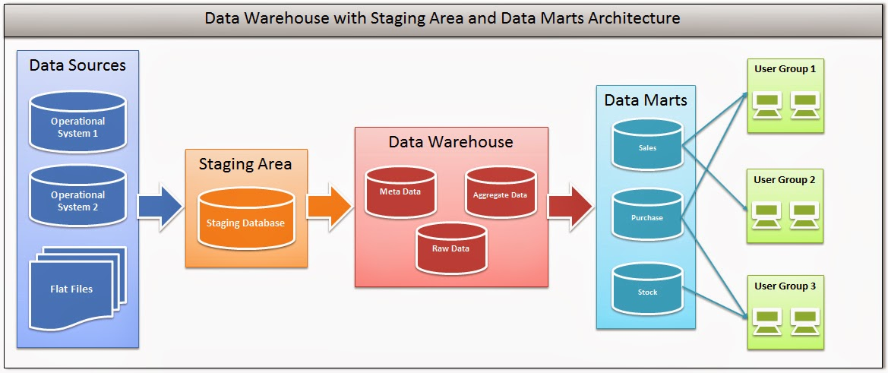
Data Warehouse
A data warehouse (DW) is a repository of historical data derived from operational systems and external data sources.
Holds multiple subject areas
Holds very detailed information
Works to integrate all data sources

Slide 7
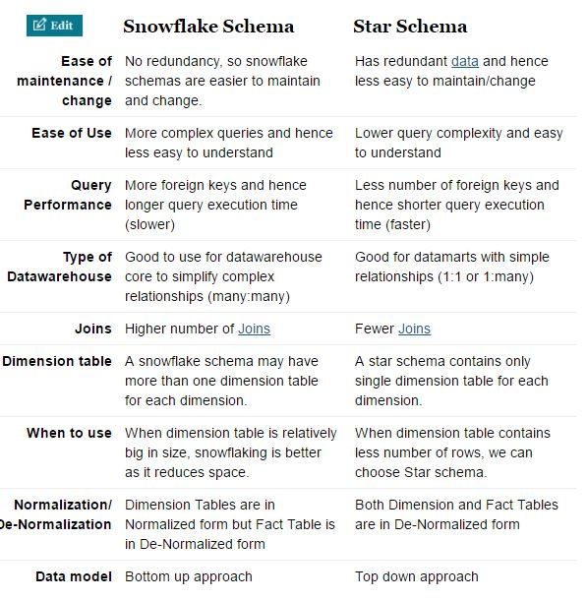
Dimension Modeling

Slide 8
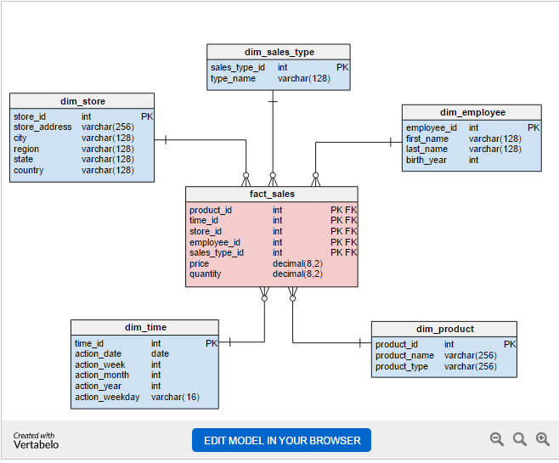
Dimension Modeling

Slide 9
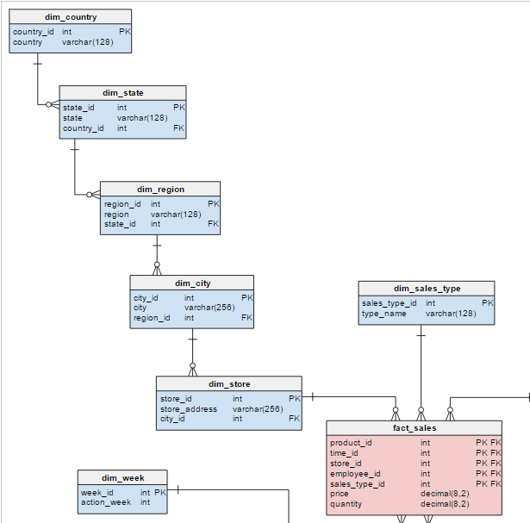
Dimension Modeling

Slide 10
Dimension and Fact
Dimension :
A dimension is the category by which summarized data can be viewed.
Dimensions describe the objects involved in a business intelligence effort.
dimensions correspond to people, items, or other objects.
For example, in the retail scenario, customers, employees, items and stores are dimensions and should be contained in dimension tables.
Dimension table would contains information about each attributes of object such as the supplier, color, sizes, and similar data

Slide 11
Dimension and Fact
Measure(Fact tables) :
A measure is numeric value that express some aspects for organizational performance.
Fact tables contain the data corresponding to a particular business process.
Each row represents a single event associated with that process and contains the measurement data associated with that event.
For example, a retail organization might have Fact tables related to customer purchases, customer service telephone calls, and product returns. The customer purchases table would likely contain information about the amount of the purchase, any discounts applied and the sales tax paid.

Slide 12
Types of Dimension
Conformed Dimensions
Junk Dimensions
Role-playing Dimensions
Slowly Changing Dimensions
Degenerated Dimensions

Slide 13
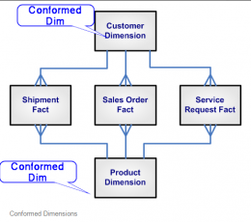
Types of Dimension
Conformed Dimensions :
A Dimension that is used in multiple locations is called conformed dimensions.
conformed dimension may be used with multiple fact tables in single database,
or across multiple data marts or Data warehouses.
e.g. Below shown Customer and Product Dimensions are Conformed Dimensions as they are connected to Shipment Fact table, Sales Order Fact table, and Service Request Fact table

Slide 14
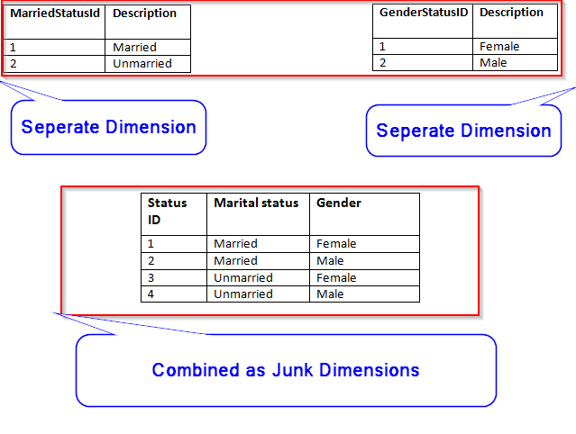
Types of Dimension
Junk Dimension:
A junk dimension is a collection of random transaction codes flags and/or text attributes that are unrelated to any particular dimension. The junk dimension is simply a structure that provides a convenient place to store the junk attributes.
Notes:
I.e.: Assume that we have a gender dimension and marital status dimension. In the fact table we need to maintain two keys referring to these dimensions. Instead of that create a junk dimension which has all the combinations of gender and marital status (cross join gender and marital status table and create a junk table). Now we can maintain only one key in the fact table.

Slide 15
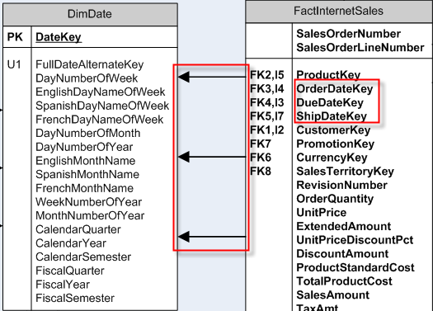
Types of Dimension
Role-playing Dimensions
Role Playing Dimensions are the Dimensions which often used for
multiple purposes within same database. Here same dimension key
is associated with more than one foreign key in the fact table in the
database for the different purposes.
Notes:
I.e.: In Date dimensions, [FullDateAlternateKey] is associated with [Orderdate key], [Duedate key], and [Shipdate] key in the fact table to solve different purpose in Data warehouse.

Slide 16
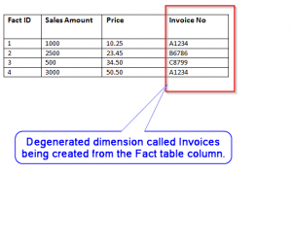
Types of Dimension
Degenerated Dimensions:
A degenerate dimension is a dimension which is derived from the fact
table and doesn’t have its own dimension table. In Data warehouse
this Dimension often used to show drill through capability where in the
report you can see how aggregated no. came up.
Notes:
I.e. Invoice no can be stored in the fact table and then used as separate dimensions for the drill through purpose to find out what invoices are part of total buying cost in report.
So Dimensions are one of the pillar of the data warehouse.Choosing right one can define future of the data warehouse.It always good to use right type

Slide 17
Types of Dimension
Slowly Changing Dimensions :
This is widely used Dimensions type. It is the dimensions where
attribute values changes with time. There are various types of
Slowly Changing Dimensions (SCD) based on how business manages
this dimensions
Types of SCD
TYPE 0: It is the dimensions where we do not change attribute values at all.
They are rarely used. I.e. Employee birth date

Slide 18
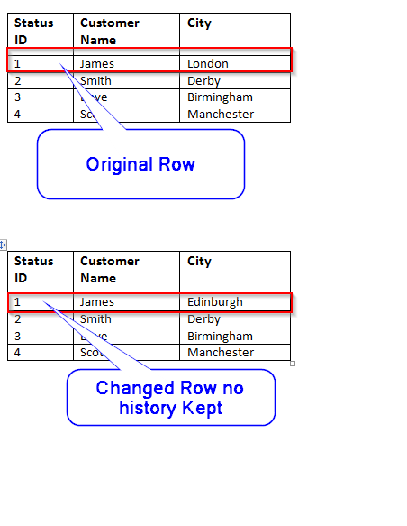
Types of Dimension
TYPE 1: In this type, Old value of attribute is overwritten by new values
of attribute and no history kept
Notes:
I.e Customer City where company decided to show only current one.

Slide 19
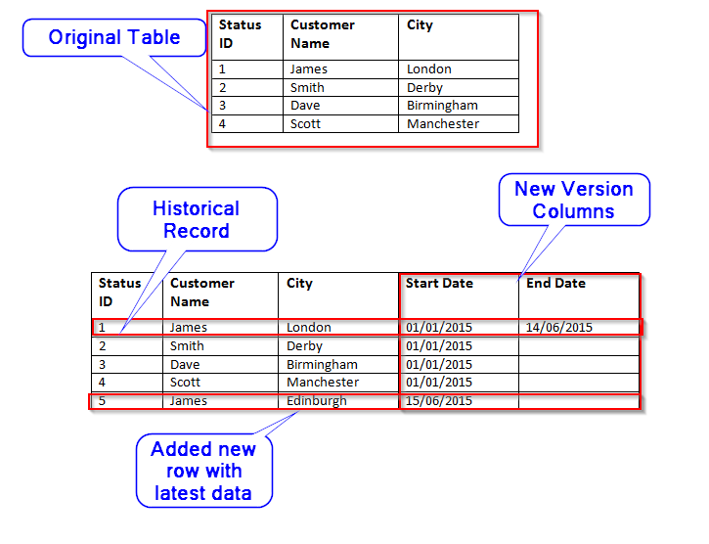
Types of Dimension
TYPE 2: In this type we tracks historical data by creating multiple records for a given Natural key (business key) in the dimensional tables with separate surrogate key and/or different version numbers. Unlimited history is preserved for each insert.
Notes:
I.e. Customer City where company decided to have historical data then we will have to add an extra row with column to identify the Current/Historical attributes value by start and end date columns.

Slide 20
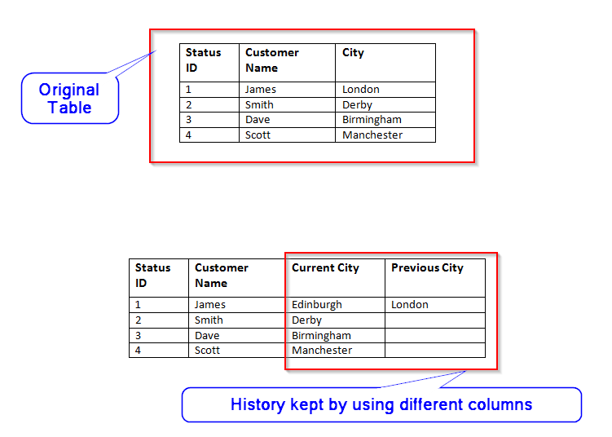
Types of Dimension
TYPE 3: In this type, we tracks changes using separate columns
and preserves limited history.it is limited to how many columns we want
to add in dimension table.
Notes:
I.e. Customer City where New columns “previous City” and “Current City” being added.

Slide 21
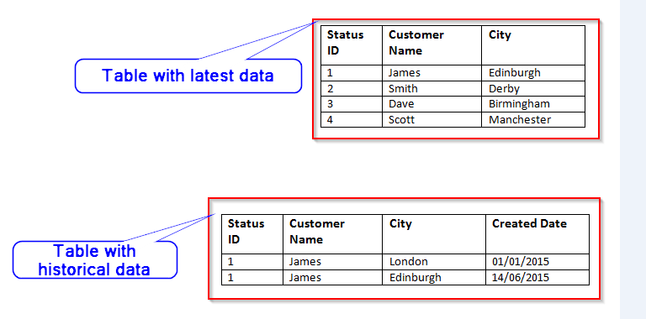
Types of Dimension
TYPE 4: In this type, we keep all or some historical data in separate
table and current data stays in main Dimension table. Both historical
and current dimension table joined to fact table with same surrogate key,
this will enhance the query performance. This type used very rarely.
Notes:
I.e. we create new table to store previous Customer City and Current Customer City in Historical table with Created date And Current Customer city in Current dimension table

Slide 22
Types of Facts
Additive Facts
Non-additive Facts
Semi-Additive Facts

Slide 23
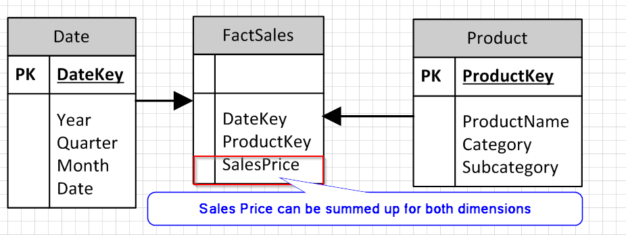
Types of Facts
Additive Facts
Additive Facts are the Facts that can be summed up through all
dimensions associated in data warehouse.e.g. Sales Price of a Product.

Slide 24
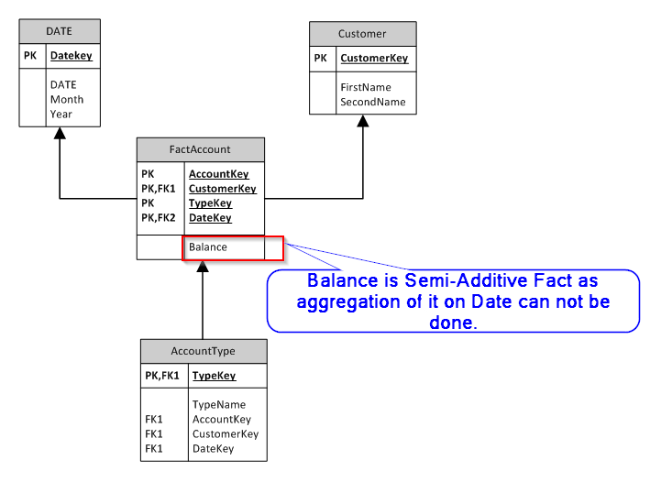
Types of Facts
Semi-Additive Facts
These are the facts which can be summed up against some dimensions,
but not all;

Slide 25
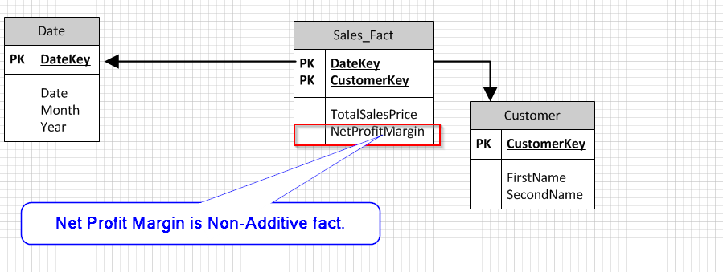
Types of Facts
Non Additive Facts
Non Additive Facts can not be summed for any dimensions related to
Fact table in Data warehouse.
Some facts are completely non additive such as ratios,% of Profit,
Profit margin etc.
Usually, These types of facts or measures derived in OLAP (CUBE) layer
of solution as Calculations.

Slide 26
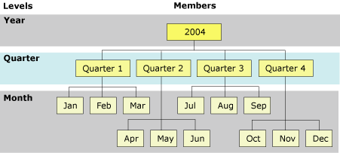
Dimension Hierarchy
Dimension Hierarchy of attributes that are used in SSAS to organize
the members of a dimension into hierarchical structures and
provide navigation paths in a cube.
e.g. Following example defines a dimension table for a
Date dimension.

Slide 27
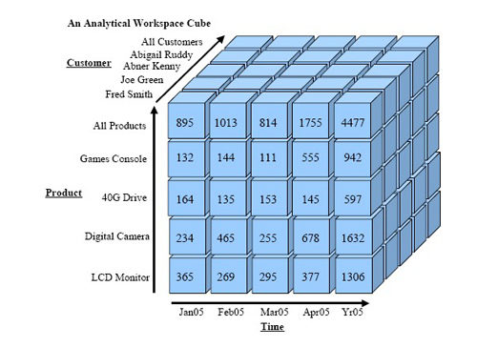
Cube
Cube
A cube is a basic storage structure which is defined by its measures
and dimensions.
The measures and dimensions in a cube are derived from the tables
and views in the data source view on which the cube is based.

Slide 28
Advantages of Cube
Performance:
A cube’s structure and pre-aggregation allows it to provide very fast responses to queries that would have required reading, grouping and summarizing millions of rows of relational star-schema data.
Drill down functionality:
The drilling and slicing and dicing that an analyst would want to perform to explore the data would be immediate using a cube but could have lengthy pauses when using a relational data source.
Multidimensional analysis:
Provides Multi dimensional Analysis of data.

Slide 29













BI Semantic Model
Your
Apps
Reporting Services
& Power View
Excel
SharePoint
Insights
PowerPivot
BI Semantic Model
Data Model
Multi-
dimensional
Tabular
Business Logic/Queries
MDX
DAX
Data Access
ROLAP
MOLAP
VertiPaq
Direct
Query
Databases
LOB Applications
Files
OData Feeds
Cloud Services
One Model for All User Experiences

Slide 30
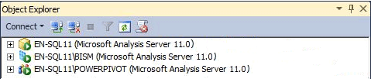
SSAS Server Modes
Multidimensional and Data Mining Mode
Power Pivot
Tabular Mode(BISM)

